Slide 1
Machine learning model
- Deep Mehta

Slide 2
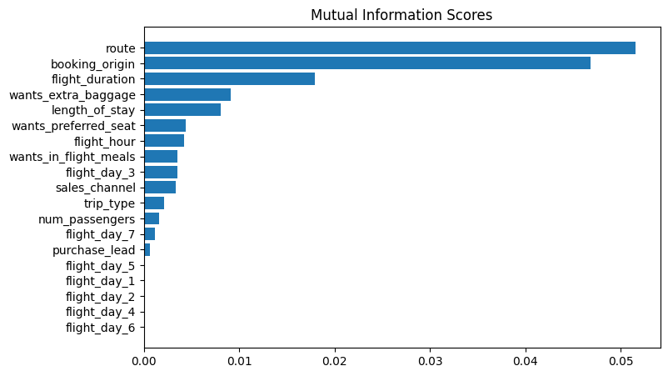
Most Important factors

